Slide 1
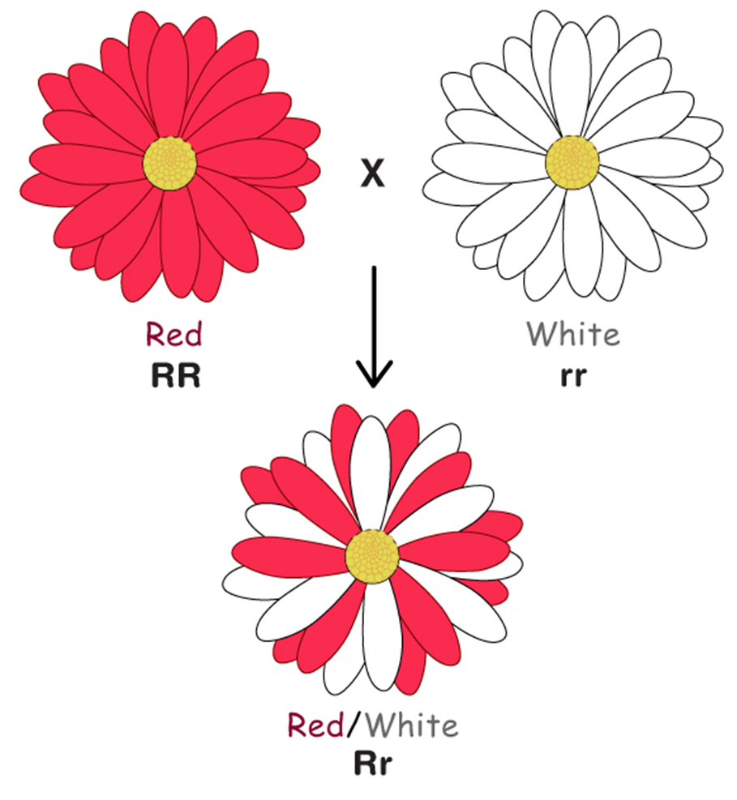
Types of Inheritance:
Codominance
AEHBY Human Biology

Slide 2
Review
In fruit flies, the allele which produces red eyes in dominant over the allele for white eyes. A heterozygous red eyed fly is crossed with a white eyed fly.
State the genotype of each parent fly.
b) State the percentage probability of genotypes and phenotypes of the offspring, show all working. (5)
2. Sketch a labelled diagram to represent the cell cycle. In which phase do specialised cells spend most of their time? (6)
3. Explain the difference between excretion and elimination (2)

Slide 3
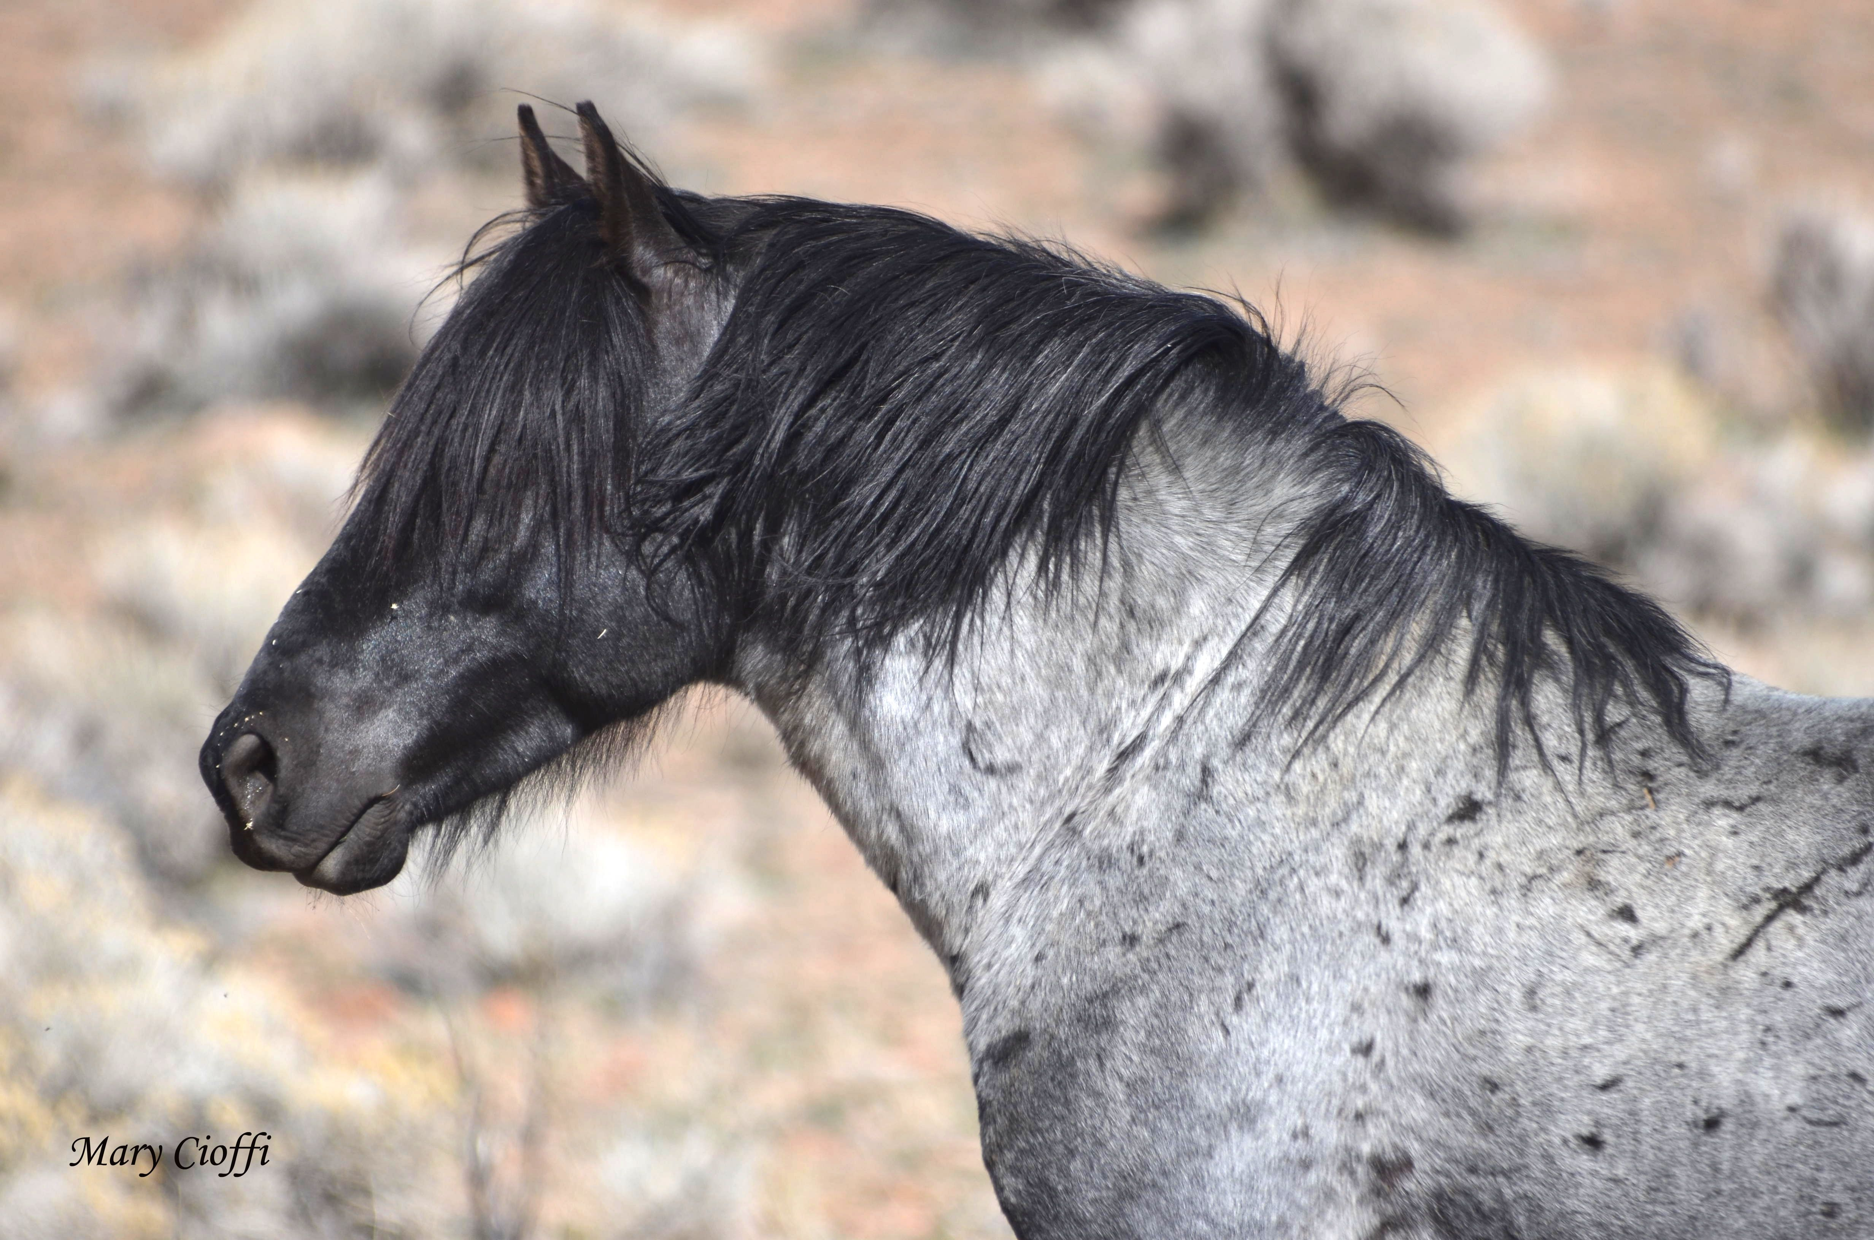
Learning Intentions
Probable frequencies of genotype and phenotype of offspring can be predicted using Punnett squares and by taking into consideration patterns of inheritance, including the effects of codominance.

Slide 4
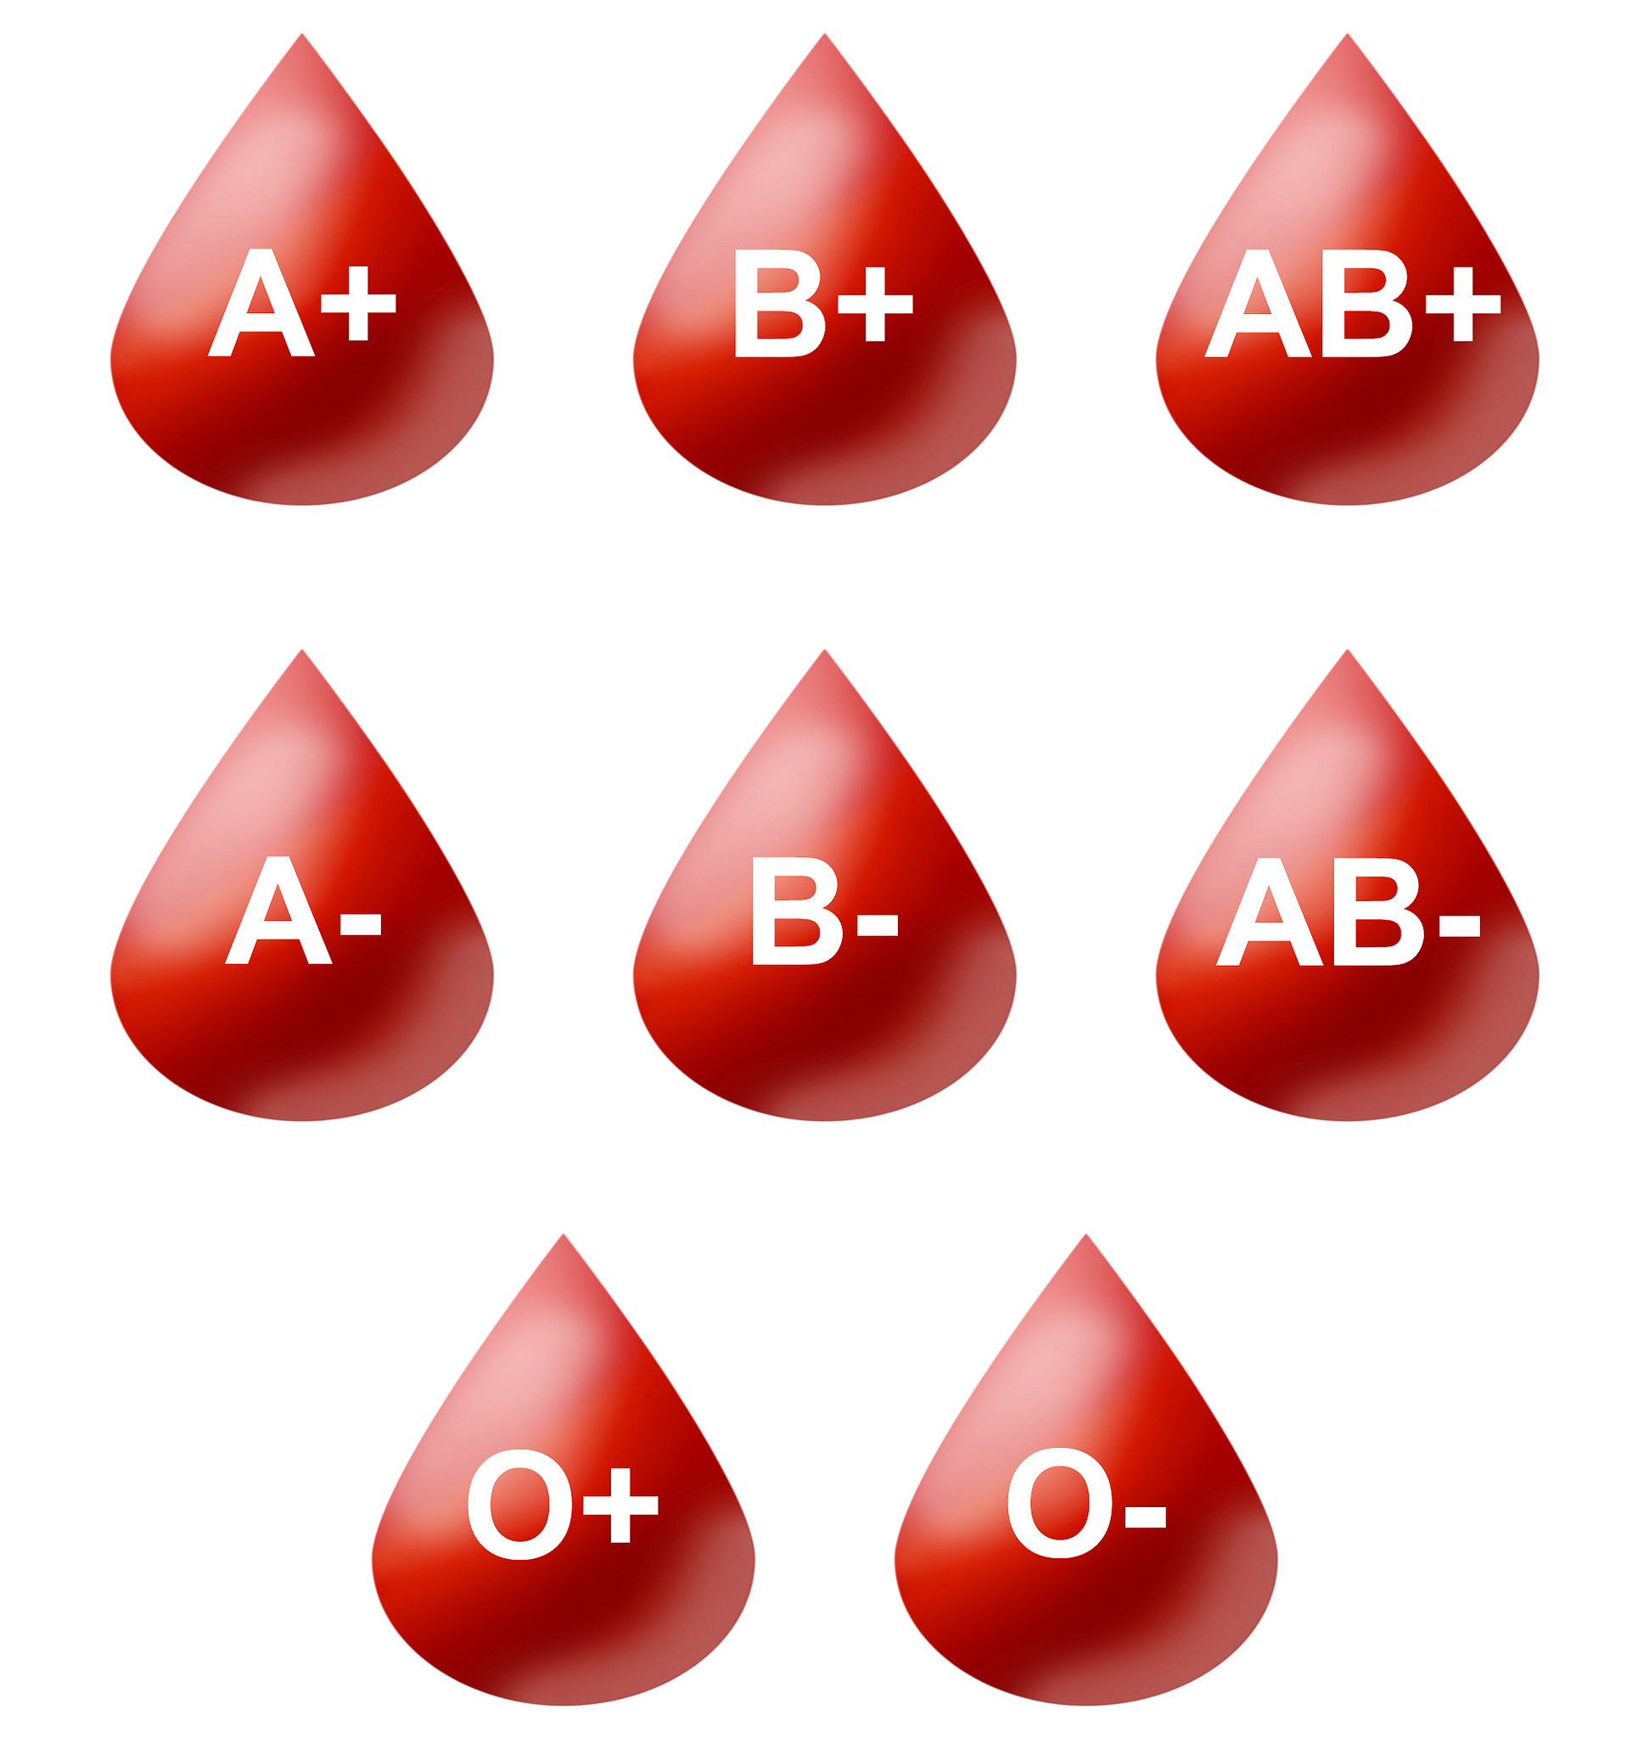
Success criteria
Define incomplete and codominance in terms of alleles, inheritance patterns, genotype and phenotype.
Give examples of incomplete and codominant.
Use Punnett squares to represent monohybrid crosses involving codominant traits.

Slide 5
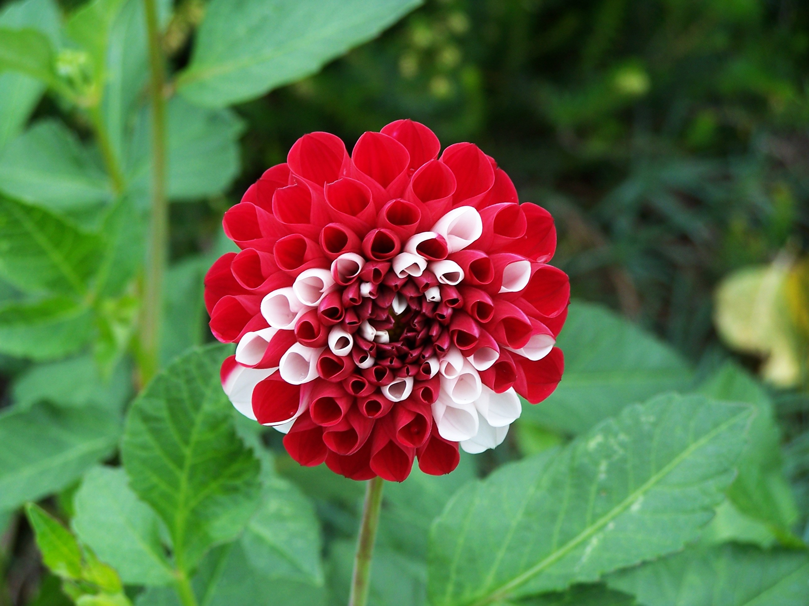

Co-dominance
For an individual that is heterozygous for a particular trait, the phenotype contains both alleles. Both genes are fully expressed.
RR: red
WW: white
RW: red and white
NB: Both are dominant, so we need to use two different capital letters
homozygous
heterozygous
phenotype

Slide 6
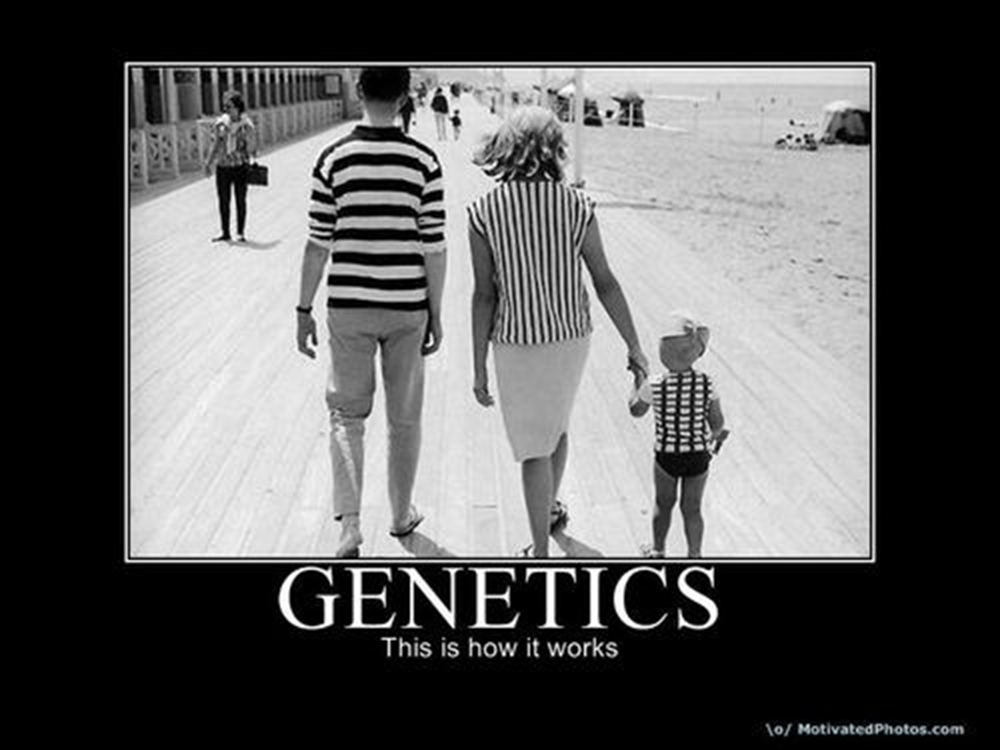

Slide 7
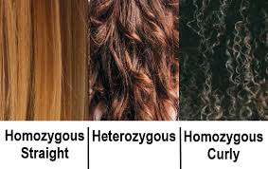
*Incomplete Dominance*
For an individual that is heterozygous for a particular trait, the phenotype is half-way between each allele. Both genes are expressed, but neither fully.
CC: curly
SS: straight
CS: wavy

Slide 8
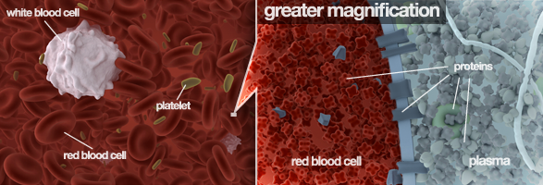
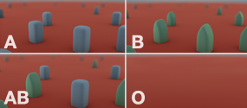

Blood groups

Slide 9
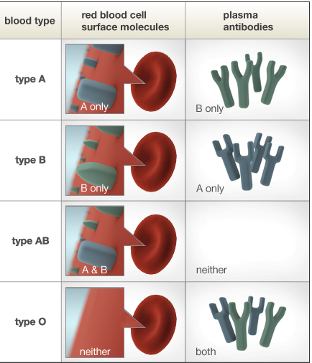

Slide 10
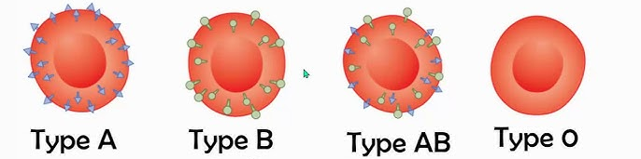
Blood Types
A is AA or Ao
B is BB or Bo
AB is AB
O is oo
o is recessive to everything else
A and B are co-dominant

Slide 11
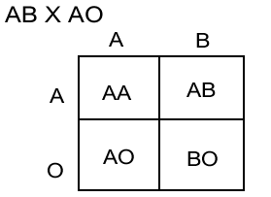




Slide 12
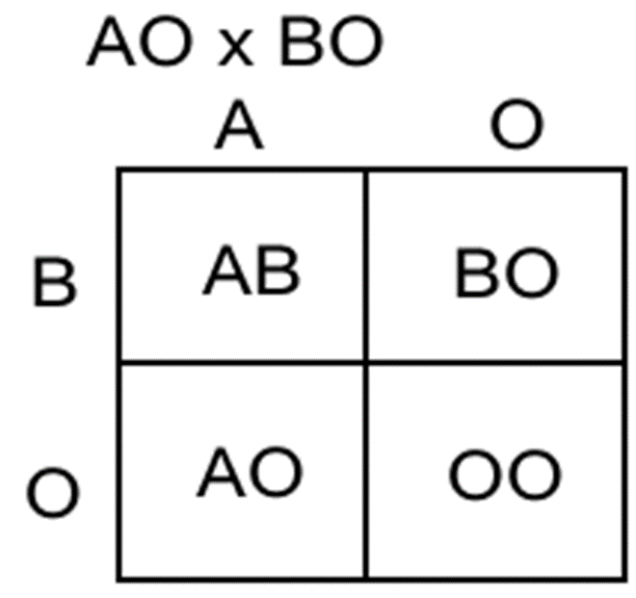



Slide 13
Success criteria
Define incomplete and codominance in terms of alleles, inheritance patterns, genotype and phenotype.
Give examples of incomplete and codominant.
Use Punnett squares to represent monohybrid crosses involving codominant traits.

